Slide 1
M.K.Gandhi
(1869-1948)

Slide 2
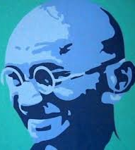
M.K.Gandhi:An Apostle of peace and non-violence

Slide 3
Spiritual Intelligence
Attitude of Acceptance
Emptiness
Einstein and Dalai Lama on Human Values
Utilitarianism and Deontology

Slide 4
Individual and society
Social welfare meant the conscious submission of the individual and a voluntary contribution of one's possession to the society, which consisted of all, not a majority and, in return, the social system, built upon the principles of non-violence and democracy, was to give a complete guarantee for the maximum development of the individual's personality.
“Recall the face of the poorest and weakest man you have seen, and ask yourself if this step you contemplate is going to be any use to him.”

Slide 5
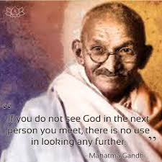

Slide 6
Gandhian ideals
Swaraj
Civilization (Machinery, Materialism, and Capitalism)
Non-Violence (Ahimsa) and Truth for Sarvodya
Moral force/Passive resistance
Spirituality
Means and Ends

Slide 7
Swaraj
Gandhi re-interprets ‘swaraj’ in the English translation as ‘self-rule’ and as ‘self-government’.
The meaning of swaraj in both its senses is: self-respect, self-realisation and self-reliance.
According to Gandhi it means rule of dharma or ‘Ramarajya’ (CW 32:489).

Slide 8
Ancient Indian Civilization
Our ancestors saw that our real happiness and health consisted in a proper use of our hands and feet. They further reasoned that large cities were a snare and a useless encumbrance and that people would not be happy in them, that there would be gangs of thieves and robbers, prostitution and vice flourishing in them and that poor men would be robbed by rich men. They were, therefore, satisfied with small villages. They saw that kings and their swords were inferior to the sword of ethics, and they, therefore, held the sovereigns of the earth to be inferior to the Rishis and the Fakirs…This nation had courts, lawyers and doctors, but they were all within bounds. Everybody knew that these professions were not particularly superior. Moreover, these vakils and vaids did not rob people, they were considered people's dependants, not their masters. Justice was tolerably fair. The ordinary rule was to avoid courts. There were no touts to lure people into them. This evil, too was noticeable only in and around capitals. The common people lived independently and followed their agricultural occupation. They enjoyed true Home Rule. And where this cursed modern civilization has not reached, India remains as it was before. (HS,What is true civilization)

Slide 9
Modern Civilization (Present)
Two unacceptable and unethical principles at the very core of modern civilization:
1. might is right
2. survival of the fittest.

Slide 10
Machine power can make a valuable contribution towards economic progress. But a few capitalists have employed machine-power regardless of the interests of the common man and that is why our condition has deteriorated today.’ (CW 87:249)

Slide 11
State and Individual
“The State represents violence in a concentrated and organized form. The individual has a soul, but as the State is a soul-less machine, it can never be weaned from the violence to which it owes its very existence".
Decentralization will be the keynote of the Non-violent State.
(Collected works)

Slide 12
What is true civilization
Civilization is that mode of conduct which points out to man the path of duty.
Performance of duty and observance of morality are convertible terms. To observe morality is to obtain mastery over our mind and our passions. So doing, we know ourselves. ( HS, 65)
True civilization, for him, was thus an aid to self-realisation and universal brotherhood, not a set of material or technological achievements, like railway trains or factory industries”[Arnold 2001:68].

Slide 13
Non-Violence and truth
Do you not tremble to think of freeing India by assassinations? What we need to do is to sacrifice ourselves. It is a cowardly thought, that of killing others. Whom do you suppose to free by assassination? The millions of India do not desire it. Those who are intoxicated by the wretched modern civilization think these things. Those who will rise to power by murder will certainly not make the nation happy.
`-M.K. Gandhi in HS

Slide 14
Active nonviolence does not seek, “to defeat or humiliate your opponents, but to win their friendship and understanding.”
“It is the acid test of non-violence, that in a non-violent conflict there is no rancor left behind and, in the end, the enemies are converted into friends.”
- M.K. Gandhi

Slide 15
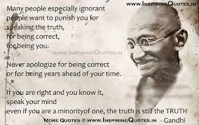

Slide 16
Passive Resistance/Soul Force/Satyagraha
A method of securing rights by personal suffering
To refuse to do a thing that is repugnant to your conscience
It is a key to self rule or home rule
It requires control over the mind
Strength of mind leads to strength of soul
To become passive resisters one has to observe perfect chastity, adopt poverty, follow truth, and cultivate fearlessness.

Slide 17
Spirituality
The goal of mankind is freedom of soul.
‘I do want growth, I do want self-determination, I do want freedom, but I want all these for the soul. I doubt if the Steel Age is an advance upon the Flint Age. I am indifferent. It is the evolution of the soul to which the intellect and all our faculties have to be devoted’ (Gandhi 1966:84).
‘Ours will only then be a truly spiritual nation when we shall show more truth than gold, greater fearlessness than pomp of power and wealth, greater charity than love of self.’ (Parel,1997:162)

Slide 18
Means lead to Ends
Perform the duties corresponding to the rights
Use the means corresponding to the end.
“If I want to deprive you of your watch, I shall certainly have to fight for it;
If l want to buy your watch, I shall have to pay you for it;
and if I want a gift, I shall have to plead for it,
and, according to the means I employ, the watch is stolen property, my own property, or a donation.
Thus we see three different results from three different means. Will you still say that means do not matter? (Gandhi, HS)

Slide 19
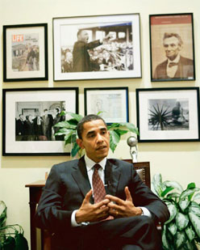
"I am mindful that I might not be standing before you today, as president of the United States, had it not been for Gandhi and the message he shared with America and the world,”
"Throughout my life, including my work as a young man on behalf of the urban poor, I have always found inspiration in the life of Gandhiji and in his simple and profound lesson to be the change we seek in the world.
www.whitehouse.gov/.../remarks-president-joint-session-indian-parliame...

Slide 20
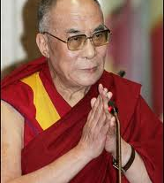
We (Tibetans) really admire Mahatma Gandhi's concept of non-violence and respect for all religions. Any person who admires his work, his views, we must implement it."

Slide 21
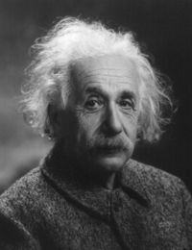
"Generations to come, it may well be, will scarce believe that such a man as this one ever in flesh and blood walked upon this Earth.” (On the occasion of Mahatma Gandhi's 70th birthday).
― Albert Einstein

Slide 22
Daily prayer of Gandhi
Devanagari
Translation
वैष्णव जन तो तेने कहिये जे पीड परायी जाणे रे। पर दुःखे उपकार करे तो ये मन अभिमान न आणे रे॥
Vaishnav (devotees of Vishnu) people are those who, Feel the pain of others, Help those who are in misery, But never let ego or conceit enter their mind.

Slide 23
How do I integrate my vow of non-violence in my daily life, while I am faced with so much violence in our society? .... during struggle, What tools can I look to so that my vow becomes a way of Being?
What does nonviolence in thought and speech mean in everyday situations?

Slide 24
Is it right to lie in order to save a life?
What are your views on Gandhi’s approach to the evils of modern civilization?
What, according to you, is the essence of Gandhi’s philosophy ?

Slide 25
Gandhian Ideals and the world today
Crisis of Capitalism (Global Recession, growing unemployment)
Bharat versus India
Inclusiveness and constructive community programmes

Slide 26
Non-Violence in Modern times
Nelson Mandela in South Africa, and Aung San Su Ki of the NLD
What is needed ‘is a moral genius of such commanding spiritual personality as to be able to unite and combine these various organized efforts into one overwhelming movement of Non-Violence which should be strong enough to sweep away on a tide of world approval, the opposing forces.’ ( Andrew, 261)

Slide 27
The discussion in Hind Swaraj on railways, Doctors, Lawyers has been grossly misunderstood by some as a discourse against modern civilization and machinery by Gandhi.In this context, Gandhji wrote on July 14,1938 : I am not aiming at destroying railways or hospitals, though I would certainly welcome their natural destruction. Neither railways nor hospitals are a test of a high and pure civilization.

Slide 28
At best they are a necessary evil. Neither adds one inch to the moral stature of a nation. Nor am I aiming at a permanent destruction of law courts, much as I regard it as a 'consummation devoutly to be wished'. Still less am I striving to destroy all machinery and mills. It requires a higher simplicity and renunciation than the people are today prepared for.

Slide 29
Hind Swaraj
1.The Congress and its officials
2. The Partition of Bengal
3. Discontent and unrest
4. What is Swaraj?
5. The condition of England
6. Civilization
7. Why was India lost?
8. The condition of India
9.The condition of India(cont.): railways
10.The condition of India(cont.): the Hindus and the Mahomedans

Slide 30
11. The condition of India(cont.): lawyers
12. The condition of India (cont.): doctors
13. What is true civilization
14. How can India become free?
15. Italy and India
16.Brute force
17.Passive resistance
18. Education
19.Machinery
20.Conclusion

